Slide 1
presentation on html overview by md raj

Slide 2
agenda
Introduction to HTML
Learning the Basic Syntax
Getting Familier With Code
Visualization
Application

Slide 3

HTML: Hyper Text Markup Language

Slide 4

Intro to HTml: it stands for hyper text markup language
Breakdown of HTML:
HyperText: Text with links which connects to other pages or resources.
Markup: tags used to structure and presentation of the content.
Language: A set of rules or protocols to establish communication between developer and browser.
It provides the basic structure to every website or web application.
It can be considered as the skeleton of the web page .
NOTE:- Father of HTML : Tim Bernes Lee , created HTML on 1991

Slide 5
Let’s see the basic structure of html :
<!DOCTYPE html>
<html lang="en">
<head>
<meta charset="UTF-8">
<meta name="viewport" content="width=device-width, initial-scale=1.0">
<title>Basic Structure of an HTML Page</title>
</head>
<body>
<p>Hello Hackers!!</p>
</body>
</html>

Slide 6
Breaking down the code:
<!DOCTYPE html>: It declares the document type and the version of HTML being used.
<html lang="en"> : Starts the HTML document and sets the language to English.
<head> : Begins the head section, that contains the meta information about the webpage.
<meta charset="UTF-8">: Sets the character set encoding to UTF-8 , supporting most characters and symbols.
<meta name="viewport" content="width=device-width, initial-scale=1.0"> : Ensures the page is responsive by setting the viewport for different devices widths.
<title>Basic Structure of an HTML Page</title>: Sets the title of the page that appears in the browser tab.
</head>: Ends the Head section.
<body>: Starts the body section where the visible content of the webpage goes.
<h1>Hello Hackers!!</h1>: Displays a heading with text “Hello Hackers!!”.
</body>: Ends the body section.
</html>: Closes the HTML Document.

Slide 7
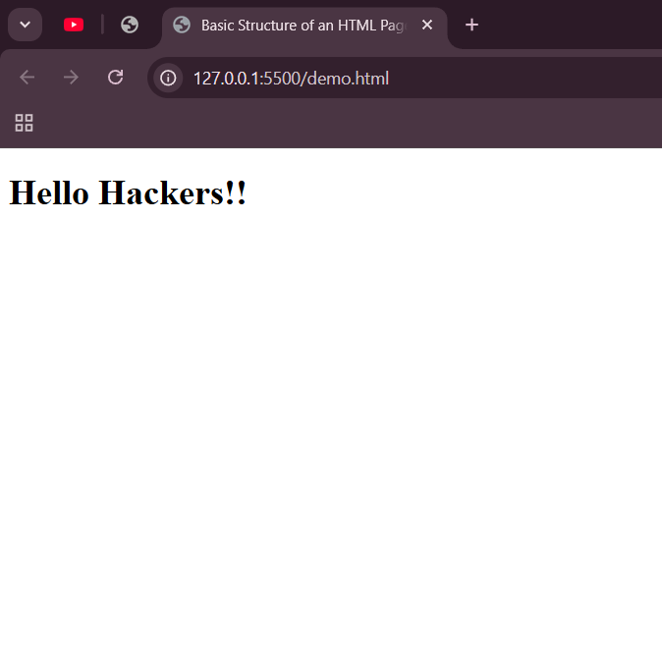
Let’s see the output in browser:

Slide 8

Application of html:
Creating Web Pages: it is the backbone of all websites. It defines the structure and content of web pages.
Embedding Media: HTML allows embedding of multimedia elements such as images, audio, and videos directly into the web pages.
Building Web Forms: HTML provides form elements for collecting user data into forms.
Linking Web Pages: HTML supports hyperlinking , allowing users to navigate between multiple web pages and online resources seamlessly.
Creating Web Applications: Along with CSS and JavaScript , HTML forms the foundation for building interactive web apps .

Slide 9
Thank you!
Md Raj
BTech. CSE
ASD-1 Year Diploma (Coding) June Batch.
rajmd1800@gmail.com

